Slide 1

SafeSpend
By Team ‘Multiverse of Sadness’
Kaustubh Athalekar
Mark Edwin Cotta
Mohammed Minsar Aga

Slide 2
Problem Statement
How can we create a money management tool to support vulnerable individuals, such as those with mental health issues or from low income families, during a pandemic or crisis?

Slide 3
Overview
The COVID-19 pandemic has highlighted the need for financial assistance. The pandemic has caused widespread job loss and economic instability, leading to financial difficulties for many individuals
These individuals may struggle to manage their finances and may not have access to traditional banking or financial services.
Therefore, there is a need for a money management tool that can support vulnerable individuals during a pandemic or crisis.

Slide 4
Why are we still talking about the pandemic? Isn’t it over?
Pandemic left lasting scars on individuals financial stability
Can affect your relationship with money for the rest of your life
Money management tools are overwhelming and bombard you with information

Slide 5
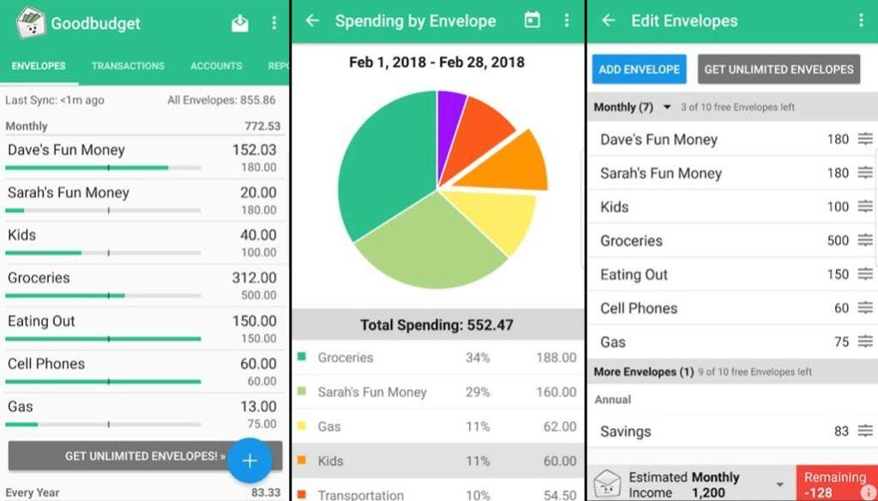
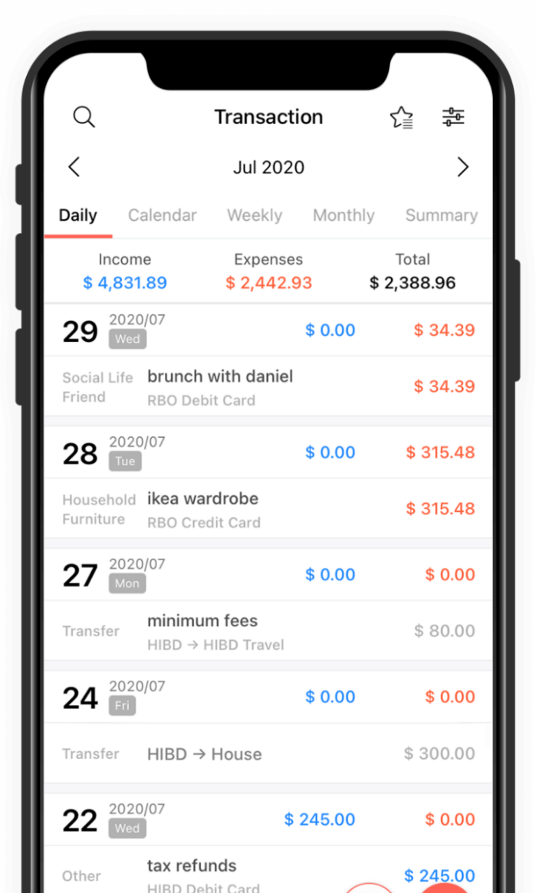
If you look at these examples they are cluttered and have very loud colours which can be very disruptive for some and can be overstimulating for people with sensory issues such as autism spectrum disorder

Slide 6
Why did we choose this topic?
We chose this topic because we felt that there wasn’t enough attention given to the negative effects that can be caused by financial instability and the problem that most Financial planners have which is clutter

Slide 7
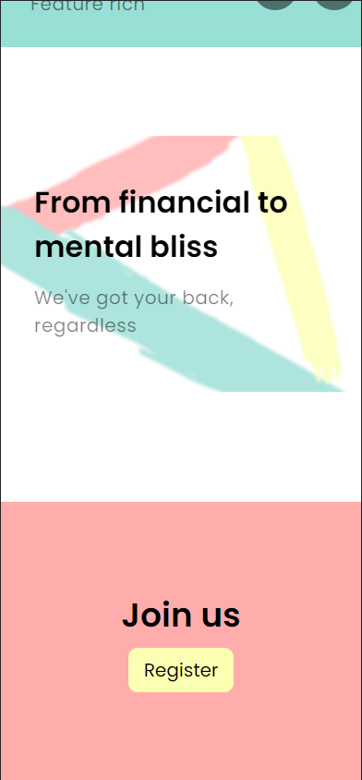
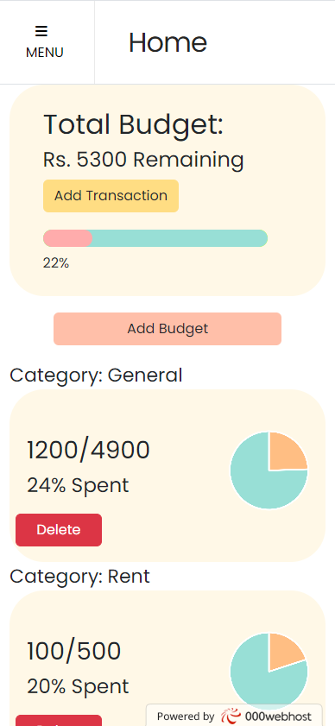
OUR SOLUTION
A minimal budget planner that is:
Easy to use
Provides a easy-to- digest visuals
Visualises data
Provides tips for the better saving and financial advice
Provides resources to help with mental health issues related to Financial stability
Portable

Slide 8
Live Demo

Slide 9







Technologies we used!
Other tools we used

Slide 10
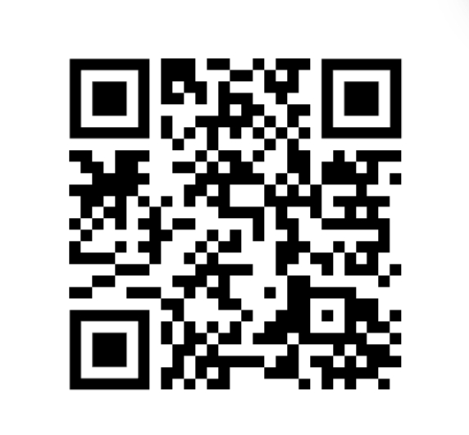
Try it yourself

Slide 11
PROBLEMS WE FACED
As this was our first hackathon we were quite overwhelmed by the whole process.
In the beginning we were thinking too big but were quickly humbled by the fast moving time and the difficulty that comes with programming but we managed to work overnight and allowed ourselves to repeatedly fail then succeed multiple times and we’re able to produce a product that we collectively happy with… overall.
Other than that we faces the usual problems with web development Another issue that we faced was the limited free resources available to us for what we envisioned to develop like we wanted to implement push notifications but all the resources we found got stopped by a paywall.

Slide 12
Conclusion and Future Scope
We hope to make this a fully functional app with all the things we had envisioned for the app like:
Customization of particular features that are aimed to help those with mental health issues:
We also want to hopefully turn this into a portal where people can donate to a variety of charities which helps those in need.

Slide 13
THANK YOU

